Slide 1
Passing the PSM I Exam
Ray Conner, PMP, PMI-ACP, SP, PSM, MBA
Sr. Manager / Sogeti Indiana Agile Lead

Slide 2
Agenda
Scrum Certifications
The PSM Certification
PSM Master Subject Areas
Scrum Theory and Principles
The Scrum Framework
Cross-Functional, Self-organizing Teams
Coaching and Facilitation
Scrum at Large
16 Review Questions throughout
Study Tips

Slide 3
Scrum certifications

Slide 4
Scrum Master Certifications
 | PSM I | CSM | PMI-ACP
Issuing Organization | Scrum.org | Scrum Alliance Inc. | Project Management Institute, Inc
Year Founded | 2009 | 2001 | 2012
Class Required | No | Yes | Yes
Class Fees | None | Varies by instructor but typically $1000 - $2000 | Classes to get the 21 PDUs required are $0-2500+. There are many free and paid classes available to obtain PDUs.
Exam Required | Yes | Yes | Yes, plus 1500 hours of Agile experience
Exam Cost | $150 per attempt | First exam free with class. Each additional attempt $25. | PMI member: $435 per attempt Non-member: $495 per attempt
Renewal | None | Every 2 Years ($150) | 30 PDUs in Agile project management per each 3 year cycle plus $150 renewal fee.
Certificates Issued (as of Dec 2014) | 30,818 | 309,309 | N/A
Industry Recognized | Yes | Yes | Yes

Slide 5
Other Scrum Certifications
PSM II
Advanced Scrum knowledge
Issued by Scrum.org
PSM I completion required
Exam format is multiple-choice questions, case study questions, and essays with a maximum duration of 120 minutes.
Fee is $500 per attempt
194 certificate holders (as of Dec 2014)
Professional Scrum Product Owner (PSPO I and II)
Geared more for the Product Owner
Issued by Scrum.org
Fee $200 per attempt and $500 per attempt respectively

Slide 6
Other Scrum Certifications
Professional Scrum Developer (PSD I)
Issued by Scrum.org
Geared for the Developers on the Development Team
Topics include
Scrum framework
Test-First Development
Continuous Integration (CI)
Emergent architecture
Fee $200 per attempt
A newer certification on Scrum.org

Slide 7
Other Scrum Certifications
Certified Scrum Professional (CSP)
Issued by Scrum Alliance Inc.
Advanced Scrum certification
Requirements
Be a current holder of an active CSM, CSPO, or CSD credential.
Have a minimum of 36 months of successful Agile/Scrum work experience gained within the past 5 years implementing Scrum inside organizations as team member, product owner, Scrum Master, or "Other."
Gather and submit 70 Scrum Education Units (SEUs) from the past three years (SEUs are given by Scrum Alliance Inc. practitioners).
No exam required.

Slide 8
The Psm certification

Slide 9
Scrum.org
Scrum.org is the institution that administers the PSM exam.
Founded by Ken Schwaber, one of the founding members of Scurm, in 2009.
Provides all of the tools and resources needed by Scrum practitioners and experts in agility to deliver value using Scrum.
A link to the latest Scrum guide is on their website.
Open Assessment is available to Scrum.org members (free membership).
Very active forum full of Scrum Masters who’ve taken the exam, are a part of a Scrum team, and some are teaching the Scrum framework.

Slide 10
PSM I Exam
80 Questions
60 minutes to complete
Multiple choice and true/false questions
85% to pass
$150 per attempt
Administered online
You have roughly 45 seconds per question (The test goes by very fast).
You can miss 12 questions and pass.
Many of the questions test your understanding of Scrum and can’t be answered by just rote learning the material.
Many questions will drop you into a situation and ask how you’d handle it using the Scrum framework.
No partial points for multiple answer questions – in most cases the number of answers you need to choose will be specified

Slide 11
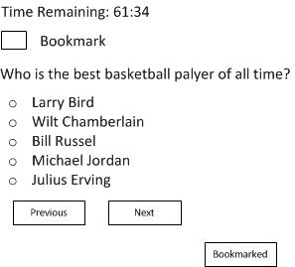
PSM I Exam Format – Question Screen
Bookmark Checkbox
Allows you to mark the question for further review later
Time Box
Counts down
Question/ Answers
Bookmark Button
Send you to the bookmark screen
Quickest way of reviewing the test
Previous Button
Returns you to the previous question
Slow way of reviewing the test
Next Button
Send you to the next question

Slide 12
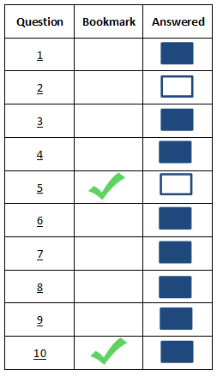
PSM I Exam Format – Bookmark Screen
Question Number
Is hyperlinked to the question.
Click the number and it’ll take you to the question.
Answer Square
Indicates questions that you’ve answered.
Solid blue squares indicate that the question has an answer
Blue outline means that the question does not have an answer selected.
Bookmark Checkmark
Indicates questions that you bookmarked.
Disappears when you uncheck the bookmark checkbox on the question screen.
On questions where you’re asked to give more than one answer (e.g. select 2 responses) if an answer is selected but not all answers that were asked for were selected the answer square will still show solid blue.

Slide 13
PSM I Exam
Master Subject Areas
Scrum Theory and Principles (Open Assessment)
The Scrum Framework (Open Assessment)
Cross-Functional, Self-organizing Teams (Self Study/Experience)
Coaching and Facilitation (Self Study/Experience)
Scrum at Large (Self Study/Experience)

Slide 14
Open Assessment
Take the open assessment multiple times – until you can see all questions are repeated ☺
Each attempt takes less than 10 minutes – worth the time
Questions are repeated from open assessment in the PSM 1 exam
Notes:
I think I took this about 15 times until I knew all the questions from open assessment.

Slide 15
Scrum theory and Principles

Slide 16
Agile Manifesto
The creators of Scrum, Jeff Sutherland and Ken Schwaber, and other developers were authors of the Agile Manifesto.
Agile Manifesto http://agilemanifesto.org/
We are uncovering better ways of developing software by doing it and helping others do it. Through this work we have come to value:
individuals and interactions | over | processes and tools
working software | over | comprehensive documentation
customer collaboration | over | contract negation
responding to change | over | following a plan
That is, while there is value in the items on the right, we value the items on the left more.
While this is not on the exam it helps to understand the thought process behind Scrum.

Slide 17
Scrum Definition
Scrum: “A framework within which people can address complex adaptive problems, while productively and creatively delivering products of the highest possible value.”
The Scrum framework consists of Scrum Teams and their associated roles, events, artifacts, and rules.
Each component within the framework serves a specific purpose and is essential to Scrum’s success and usage.

Slide 18
Scrum Framework
Scrum is
Lightweight
Simple to understand
Difficult to master

Slide 19

Empiricism
Empiricism - knowledge comes from experience and making decisions based on what is known. Scrum employs an iterative, incremental approach to optimize predictability and control risk.
Empirical Process Control
Transparency - Significant aspects of the process must be visible to those responsible for the outcome.
Inspection - Frequent examination of Scrum artifacts and progress toward a Sprint Goal to detect undesirable variances.
Adaptation - If one or more aspects of a process deviate outside acceptable limits, and that the resulting product will be unacceptable, the process or the material being processed must be adjusted.
Transparency
Inspection
Adaptation

Slide 20

Scrum Values

Slide 21

Review Question #1
Which statement best describes Scrum?
A complete methodology that defines how to develop software.
A cookbook that defines best practices for software development.
A framework within which complex products in complex environments are developed.
A defined and predictive process that conforms to the principles of Scientific Management.
Notes:
C

Slide 22
Review Question #2
Upon what type of process control is Scrum based?
Empirical
Hybrid
Defined
Complex
Notes:
A

Slide 23
Review Question #3
The three pillars of empirical process control are:
Respect For People, Kaizen, Eliminating Waste
Planning, Demonstration, Retrospective
Inspection, Transparency, Adaptation
Planning, Inspection, Adaptation
Transparency, Eliminating Waste, Kaizen
Notes:
C

Slide 24
THE Scrum FRAMEWORK

Slide 25

The Scrum Team
Product Owner
Scrum Master
Development Team
Self-organizing - choose how best to accomplish their work, rather than being directed by others outside the team.
Cross-functional - have all competencies needed to accomplish the work without depending on others not part of the team.
Team Model – designed to optimize flexibility, creativity and productivity.
Notes:
Scrum Teams deliver products iteratively and incrementally, maximizing opportunities for feedback. Incremental deliveries of “Done” product ensure a potentially useful version of working product is always available.

Slide 26
The Product Owner
Product Owner
1 Person
Full time or part time
Business Oriented
Only person responsible for the Product Backlog
Gather requirements from the stakeholders
May represent the desires of a committee
Ultimately, has the final say in the product backlog
Responsibilities
Maximize the value of the product and the work of the Development Team.
Manage the Product Backlog.
Maximize the value of the product and the work of the Development Team.
Make sure the Development Team understands the items in the Product Backlog.
Notes:
The product owner may do the above work, or have the development team do it, however remains accountable for the same.

Slide 27
The Development Team
Development Team
3 – 9 People
No titles and no sub-teams
Everyone on the team has the same title: developer.
There are no testers or QA group or BA etc.
Individuals may have areas of expertise but accountability lies on the group.
Self-organizing – No one tells the Development Team how to turn Product Backlog into Increments of potentially releasable functionality.
Cross functional – Everyone on the team has the necessary skills to turn product backlog items into a increment of functionality.

Slide 28
The Development Team
Development Team
The Development Team should change very little.
There is a decrease in productivity when the team changes.
Only the Development Team can create an increment of “Done.”
No outside help is necessary for the Development Team to create and increment of functionality.
Responsibilities
Turn the product backlog into increments of functionality that is potentially releasable and adhere to the definition of done.
Attend all of the Scrum events.
Notes:
They are self-organizing. No one (not even the Scrum Master) tells the Development Team how to turn Product Backlog into Increments of potentially releasable functionality;
Development Teams are cross-functional, with all of the skills as a team necessary to create a product Increment;

Slide 29
The Scrum Master
Scrum Master
1 person
Full-time or part-time
Fully understand the Scrum framework.
Manages the Scrum framework, but doesn’t manage the team.
Works to maximize the value created by the Scrum team.
Responsibilities
Lead and coach the Product Owner, Development Team, and organization on how to implement Scrum.
Make sure that the Scrum Team and organization follows the Scrum theory, practices, and rules and coaches when there are deviations from the framework.
Remove impediments to the Development Team’s progress.

Slide 30
Review Question #4
Who is on the Scrum Team?
Select all answers that apply
Product Owner
Product Manager
QA Team
The CEO
Scrum Master
Development Team
Notes:
A, E, F

Slide 31
Review Question #5
Who can remove a team member from the Development Team?
Product Owner
Development Team
Product Manager
Scrum Master
Human Resources (HR)
Notes:
B

Slide 32
Review Question #6
The Development Team should have all the skills needed to:
Turn the Product Backlog items it selects into an increment of potentially shippable product functionality.
Complete the project as estimated when the date and cost are committed to the Product Owner.
Do all of the development work, but not the types of testing that require specialized testing, tools, and environments.
Notes:
A

Slide 33
Review Question #7
Do Scrum Teams need a Product Owner and/or Scrum Master?
Yes, both positions are needed 100% of the time.
Yes, both positions are needed, but they can be part time.
The Product Owner can be replaced by a committee that manages the product backlog.
The Scrum Master is not needed. As soon as the team understands the Scrum framework and has proven it can work independently.
The Product Owner and Scrum Master are not needed, because they don’t contribute to the increment of functionality.
Notes:
B

Slide 34
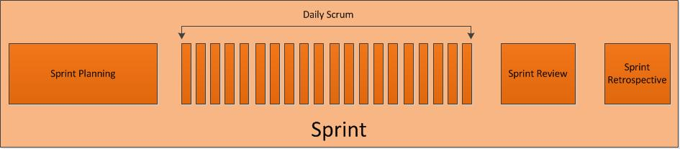
Scrum Events
Each event is time boxed which means every event has a maximum duration, but can be cut short if the purpose of the event has been achieved.
Every event is a formal opportunity to inspect and adapt.
The events create regularity and minimize the need for meetings not defined in Scrum.

Slide 35
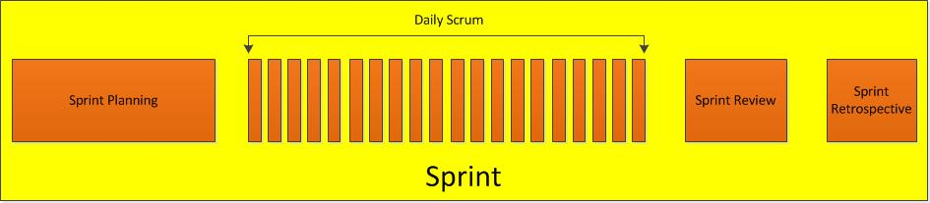
The Sprint
Sprint objective - Creation of a “Done”, useable, and potentially releasable product increment.
The time box is 4 weeks (one month) or less.
The duration should not change during the sprint and should rarely change throughout the project
Sprints contain:
Sprint Planning | Sprint Review
Daily Scrums | Sprint Retrospective
development work

Slide 36
The Sprint
The next sprint begins immediately after the last sprint ends.
During the Sprint:
No changes are made that would endanger the Sprint Goal.
Quality goals do not decrease.
Scope may be clarified and re-negotiated between the Product Owner and Development Team as more is learned.
A sprint can be canceled by the Product Owner if the Sprint Goal becomes obsolete.

Slide 37
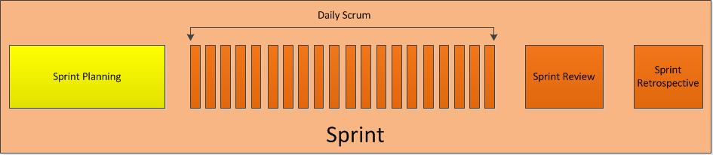
Sprint Planning
Sprint Planning objective:
The Development Team forecasts of the amount of work to be done this sprint and selects items from the Product Backlog.
Creation of the sprint goal (objective that will be met within the Sprint through the implementation of the Product Backlog).
Explanation by the Development Team to the Product Owner and Scrum Master on how it intends to work as a self-organizing team to accomplish the Sprint Goal and create the anticipated Increment.
The time box is 8 hours when the sprint is 4 weeks (a month). For shorter Sprints it is usually shorter.

Slide 38
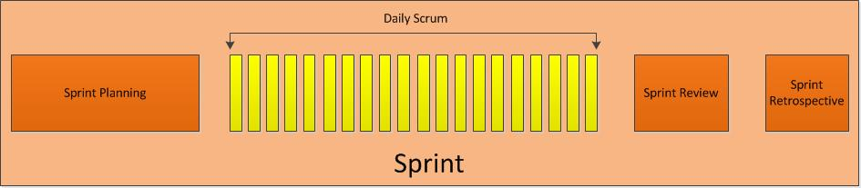
Daily Scrum
Daily Scrum objective - Inspecting the work since the last Daily Scrum and forecasting the work that could be done before the next one.
The time box is 15 minutes.
The Scrum Master and the Development team are the only people allowed to participate in the Daily Scrum.
The Development Team is responsible conducting the Daily Scrum.
The Scrum Master ensures that the daily Scrum is occurs and is kept within the 15 minute time box.

Slide 39
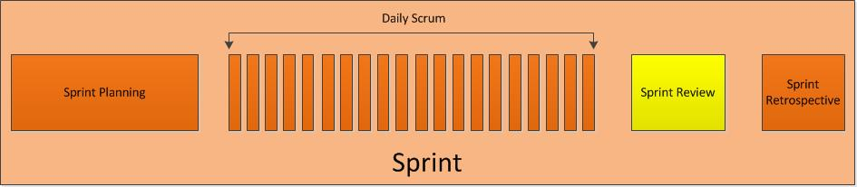
Sprint Review
Sprint Review objective:
Scrum Team and stakeholders collaborate about what was done in the Sprint.
Based on that and any changes to the Product Backlog during the Sprint, attendees collaborate on the next things that could be done to optimize value.
The time box is 4 hours when the sprint is 4 weeks (a month). For shorter Sprints it is usually shorter.
Result of the Sprint Review: A Revised Product Backlog that defines the probable Product Backlog items for the next Sprint.

Slide 40
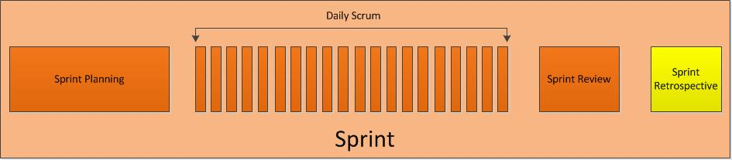
Sprint Retrospective
Sprint Retrospective objective:
Inspect how the last Sprint went with regards to people, relationships, process, and tools;
Identify and order the major items that went well and potential improvements; and,
Create a plan for implementing improvements to the way the Scrum Team does its work.
The time box is 3 hours when the sprint is 4 weeks (a month). For shorter Sprints it is usually shorter.
There aren’t many questions on the PSM that cover the Sprint Retrospective

Slide 41
Review Question #8
The time box for a Daily Scrum is?
The same time of day every day.
Two minutes per person.
4 hours.
15 minutes.
15 minutes for a 4 week sprint. For shorter Sprints it is usually shorter.
Notes:
D.

Slide 42
Review Question #9
Who determines the amount of work that is to be completed during the sprint?
Scrum Master
Development Team
Product Owner
A and B
A and C
B and C
A, B, and C
Notes:
B.

Slide 43
Review Question #10
Which of the following is a topic for the Product Owner if the sprint is in progress? Select all answers that apply
Answer questions from the Development Team about items in the current Sprint.
Reorder the Product Backlog based on new market conditions.
Working together with the stakeholders.
Update the Sprint burndown chart.
Provide feedback.
Notes:
A, B, C, E

Slide 44
Review Question #11
If the development team does not have all of the skills to accomplish the sprint goal, the Scrum Master should:
Cancel the sprint.
Cancel SCRUM.
Have the development team determine the definition of “Done” and work through the spring backlog.
None of the above
Notes:
C.

Slide 45
Review Question #12
The Scrum Master realizes that Product Owner attends all Daily Scrums and asks Team Members about their tasks and gives them directions for the following day. What should the Scrum Master do?
It’s wrong, the Product Owner should not attend Daily Scrum.
It’s wrong, the Product Owner should not speak in the Daily Scrum.
It’s OK, the Product Owner is a part of the business and functions like a Project Manager in Scrum.
It’s OK, it’s recommended for the Product Owner to give direction.
Notes:
B.

Slide 46
Review Question #13
The Development team does not see the benefit in Sprint Retrospective and are considering canceling the remainder Sprint Retrospectives. What action should the Scrum Master take?
Allow the Development Team to cancel the Sprint Retrospectives. Development Teams are structured and empowered by the organization to organize and manage their own work.
Allow the Development Team to cancel the Sprint Retrospectives. Development Teams are self-organizing. No one (not even the Scrum Master) tells the Development Team how to turn Product Backlog into increments of potentially releasable functionality.
Don’t allow the Development Team to cancel the Sprint Retrospectives. The Scrum Master’s role is to manage the Development Team and to make sure Scrum procedures are followed.
Don’t allow the Development Team to cancel the Sprint Retrospectives. Sprint Retrospectives are an integral part of Scrum that allows the team to inspect and adapt. The Scrum Master should coach the team to understand the purpose of the Sprint Retrospective.
Notes:
D.

Slide 47
Scrum Artifacts

Slide 48
Product Backlog
Product Backlog: an ordered list of everything that might be needed in the product and is the single source of requirements for any changes to be made to the product.
The Product Backlog lists all features, functions, requirements, enhancements, and fixes that constitute the changes to be made to the product in future releases.
As feedback from the Scrum events is received the Product Backlog will change.
Changes in business requirements, market conditions, or technology may cause changes in the Product Backlog.
The Product Owner is responsible for the Product Backlog’s:
Content
Availability
Order
The Development Team is responsible for estimating the work for each product backlog attribute

Slide 49
Product Backlog
Product Backlog refinement is the act of adding detail, estimates, and order to items in the Product Backlog.
This is an ongoing process in which the Product Owner and the Development Team collaborate on the details of Product Backlog items.
The Product Backlog is never complete. It evolves as the product and the environment change. It is dynamic.
When multiple Scrum teams work on the same product there is only one product backlog.

Slide 50
Sprint Backlog
Sprint Backlog: the set of Product Backlog items selected for the Sprint, plus a plan for delivering the product Increment and realizing the Sprint Goal.
The Sprint Backlog makes visible all of the work that the Development Team identifies as necessary to meet the Sprint Goal.
The Sprint Backlog is determined during the Sprint Planning.
Only the Development Team can change its Sprint Backlog during a Sprint.

Slide 51
Increment
Increment - the sum of all the Product Backlog items completed during a Sprint and the value of the increments of all previous Sprints.
The increment must be “Done” which means it’s useable and meets the Scrum team’s definition of “Done.”
The Product Owner may or may not decide to release the increment, but it should be releasable.

Slide 52
Definition of “Done”
“Done”: a shared understanding of what it means for work to be complete, to ensure transparency.
Guides the Development Team in knowing how many Product Backlog items it can select during a Sprint Planning.
Each Increment is additive to all prior Increments and thoroughly tested, ensuring that all Increments work together.
For multiple Scrum Teams working on the system or product release all of the Scrum Teams must jointly define the definition of “Done.”

Slide 53
Monitoring Progress
Burn Down Chart - shows the amount of remaining work
Release Burn Down - measures remaining Product Backlog across the time of a release plan.
The Product Owner is responsible for updating the Release Burn Down.
Sprint Burn Down: measures remaining Sprint Backlog items across the time of a Sprint.
From the latest Guide (2016): The Development Team tracks this total work remaining at least for every Daily Scrum. The Development Team tracks these sums daily and projects the likelihood of achieving the Sprint Goal.
Burn Down charts are not in the latest Scrum Guide 2016, but do show up on the exam.

Slide 54
Monitoring Progress

Slide 55
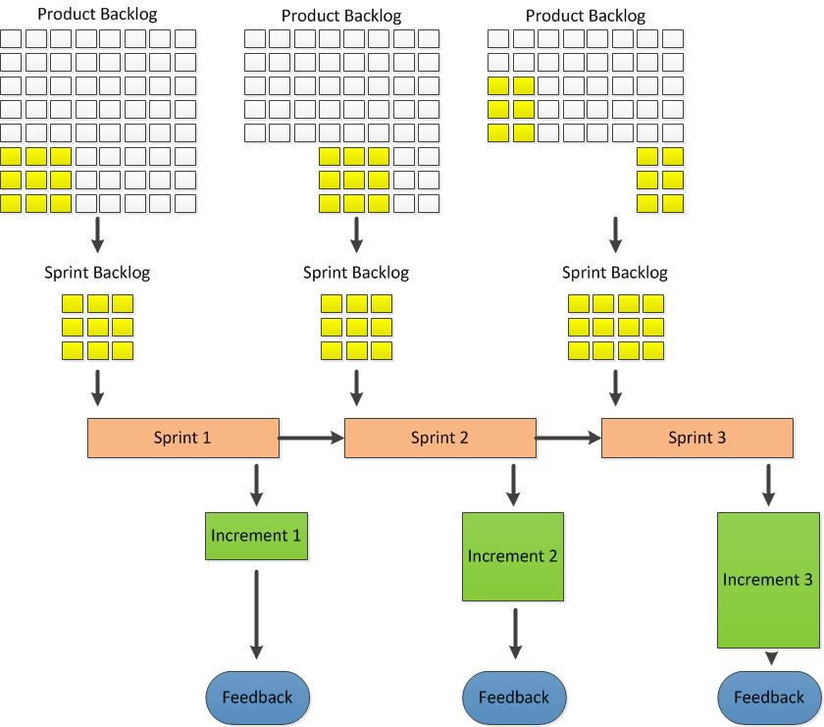
Scrum Artifact Flow

Slide 56
Definition of “Done”
Every one must understand what “Done” means and have a shared understanding of what is complete.
Guides team in how many Backlog items it can select in Sprint Planning.
Team most follow, at a minimum, the organization’s definition of done if available.
Multiple scrum teams working on same product must mutually define the definition of done.
As Scrum Teams mature it is expected the DoD will expand to include more stringent criteria for higher quality.

Slide 57
Review Question #14
What happens to the definition of “Done” when multiple Development Teams are working on a single product?
Each team defines its own “Done”, and communicates it with others so that everyone knows what it means when a team claims that they are Done with something.
Each team defines its own “Done”, in a way that the integration of their work results in a definition of “Done” that is potentially releasable.
They all use the same definition of “Done.”
Any of the above answers, based on the nature of the project and the environment of the organization.
Notes:
C.

Slide 58
Review Question #15
Can the Scrum Team deliver only documentation at the end of the sprint if the Product Owner asks for it?
Yes, As long as the documentation is a part of the Sprint Backlog and delivers value to the organization.
Yes, documentation is essential in recording the Scrum Team’s progress.
No, the purpose of a sprint is to produce a working increment on functionality.
No, documentation is not important in Scrum Teams and is not mentioned in the most recent Scrum Guide.
Notes:
C.

Slide 59
Review Question #16
Which best describes the Release Burn Down Chart?
The Release Burn Down shows the work remaining in the Product Backlog.
The Release Burn Down shows the work remaining in the Sprint Backlog.
The Release Burn Down shows the work completed in the Product Backlog.
The Release Burn Down shows the work completed in the Sprint Backlog.
Notes:
A

Slide 60
Cross Functional, self-organizing Teams

Slide 61
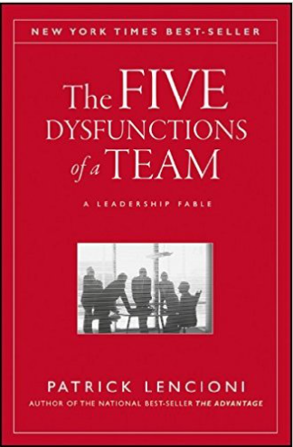
the five dysfunctions of a team are are: Absence of trust— unwilling to be vulnerable within the group Fear of conflict— seeking artificial harmony over constructive passionate debate Lack of commitment— feigning buy-in for group decisions creates ambiguity throughout the organization Avoidance of accountability— ducking the responsibility to call peers on counterproductive behavior which sets low standards Inattention to results— focusing on personal success, status and ego before team success

Slide 62

To motivate employees who work beyond basic tasks, give them these three factors to increase performance and satisfaction: Autonomy — Our desire to be self directed. It increases engagement over compliance. Mastery — The urge to get better skills. Purpose — The desire to do something that has meaning and is important. Businesses that only focus on profits without valuing purpose will end up with poor customer service and unhappy employees.^{[6]}

Slide 63
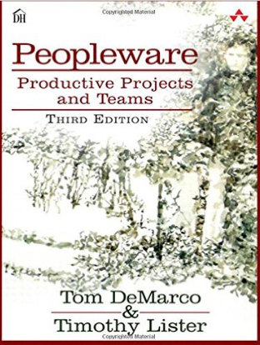
Peopleware: Productive Projects and Teams group chemistry and team jelling "flow time“ quiet in the work environment the high cost of turnover the conflicts between individual work perspective and corporate ideology, corporate entropy “teamicide” workspace theory

Slide 64
Coaching and Facilitating

Slide 65
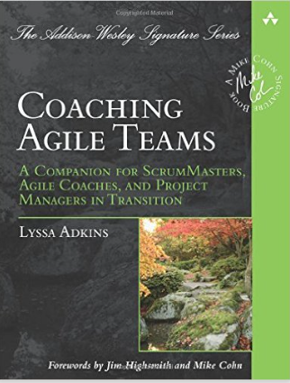
Provides understanding what it takes to be a great agile coach: Mastering all of the agile coach’s roles: teacher, mentor, problem solver, conflict navigator, and performance coach. Creating an environment where self-organized, high-performance teams can emerge. Coaching teams past cooperation and into full collaboration. Evolving leadership style as the team grows and changes. Staying actively engaged without dominating the team and stunting its growth. Recognizing failure, recovery, and success modes in coaching. Getting the most out of your personal agile coaching journey.
Coaching Agile Teams

Slide 66
SCRUM AT large

Slide 67

The Enterprise and Scrum
Scrum Masters can identify waste and scaling options within a team to increase the effectiveness of the team in delivering releasable software.
Scrum Masters can guide an organization in scaling to multiple Scrum Teams working on one software product and in aligning development on product lines or multiple interconnected products.

Slide 68
Study Tips
Read and understand the Scrum Guide (latest guide link on scrum.org).
(http://www.scrumguides.org/scrum-guide.html)
Take the Open Assessment on scrum.org.
Some (all) of the Open Assessment’s questions are in the PSM.
Do the Developer Assessment on scrum.org.
A different question bank than the Open Assessment. Some questions don’t apply, but going through this assessment allows you to see some different questions.
Watch Scrum Training Series Videos.
http://scrumtrainingseries.com/
Cartoon characters that guide you through the process and is full of info and quizzes.
Use the Scrum.org forums to ask questions and view messages.
There are a lot of really smart people discussing Scrum.
There are very deep discussions about the framework.
Read Scrum - A Pocket Guide (Best Practice)
It gets to the heart of why Scrum is setup the way it is
http://amzn.com/9087537204
Notes:
A

Slide 69


Good Luck

Slide 70
Answers to the Review Questions
C A C A, E, F B A B D B | A, B, C, E C B D C C A

